Slide 1
CAPSTONE PROJECT
Data Analysis Using Python

Slide 2
PROJECT OBJECTIVE
The objective of the project is to use Python programming to analyze a movie data to perform exploratory data analysis by answering the questions in the upcoming slides.

Slide 3
TMDB MOVIE DATA ANALYSIS
Movies that cost over $100 million can still fail, why so? Movie lovers might have different interests.
A production company wants to analyze a movie dataset to identify what kinds of movies perform well in cinemas, which genres they belong to, and so on. It will help the company predict if the movie will be a commercial success, if the movie will be highly rated, etc.
To begin with the management has asked Peter, a data analyst, to answer certain questions by carrying out the upcoming tasks.
You are required to help Peter write Python codes in a Python notebook to perform these tasks.

Slide 4
01
TASK

Slide 5
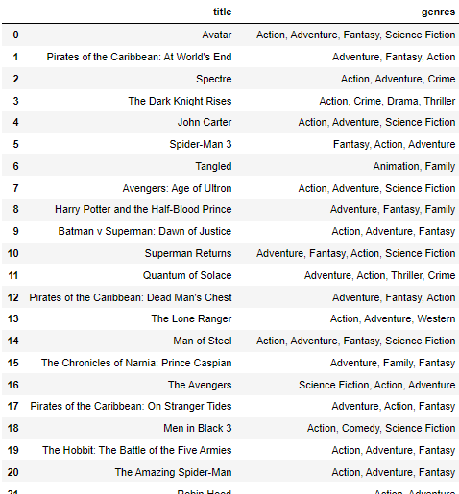

01
TASK
Load the movie dataset in Python notebook. Display the numbers of rows and columns in the dataset. Display the titles and genres of first 50 movies from the dataset.

Slide 6
02
TASK

Slide 7
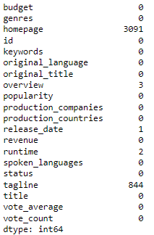
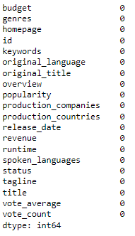
02
TASK
Identify the columns that have null values and perform the null value treatment. (Choose the imputation method based on the type of data in columns of interest)

Slide 8
03
TASK

Slide 9
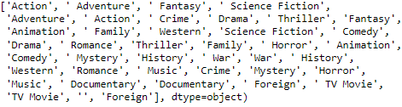
03
TASK
Display the movie categories that have a budget greater than $220,000.

Slide 10
04
TASK

Slide 11

04
TASK
Display the movie categories where revenue is greater than $961,000,000.

Slide 12
05
TASK

Slide 13
05
TASK
In the dataset, there are some movies for which the budget and revenue columns have the value 0, which means unknown values. Remove the rows with value 0 from both budget and revenue columns.
In this task I have dropped the rows with value 0 from both budget and revenue columns.

Slide 14
06
TASK

Slide 15
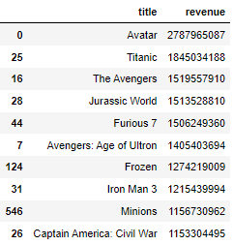
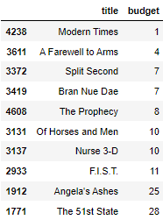
06
TASK
List the top 10 movies with the highest revenues and the top 10 movies with the least budget.

Slide 16
07
TASK

Slide 17
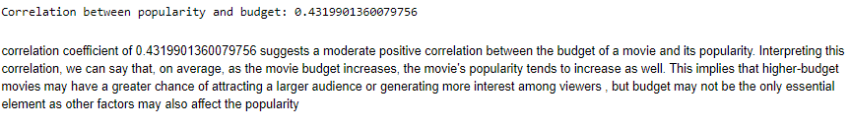
07
TASK
How are popularities of movies related with movie budgets ? Are they correlated or totally uncorrelated with each other? Write the interpretation of your analysis.

Slide 18
08
TASK

Slide 19
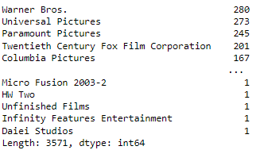
08
TASK
Identify and display the names of all production companies along with the number of times they appear in the dataset.

Slide 20
09
TASK

Slide 21
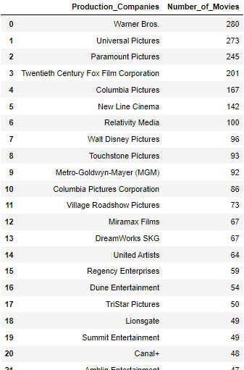
09
TASK
Display the names of the top 25 production companies based on the number of movies they have produced in descending order of the number of movies produced.

Slide 22
10
TASK

Slide 23
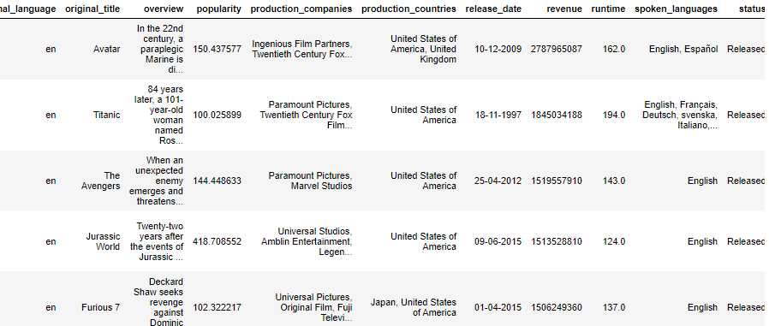
10
TASK
Sort the data in descending order based on revenue and filter the top 500 movies. Find the measures of central tendency for the following columns using the filtered data:
Budget
Revenue
Runtime
Perform outlier analysis for the above three columns using box plots.

Slide 24
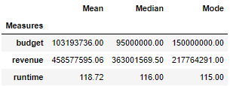
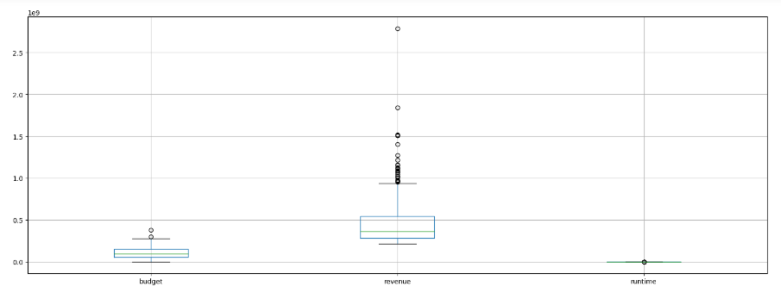
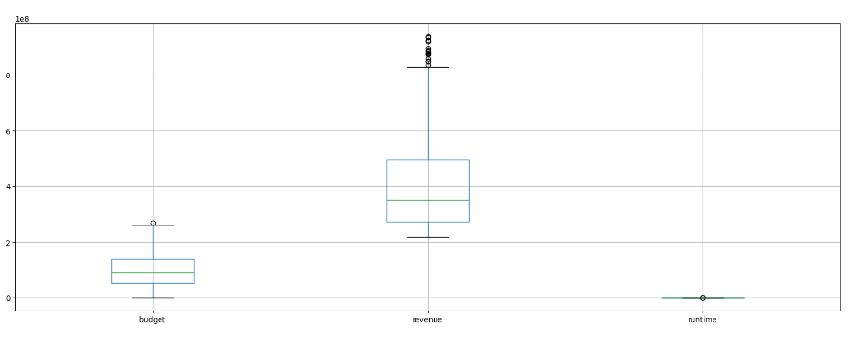
10
TASK

Slide 25
11
TASK

Slide 26
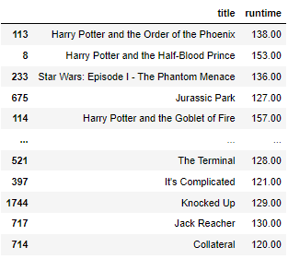
11
TASK
Identify and display the names of the movies along with their runtime for those movies that have above average runtime, using the data from previous task.

Slide 27
THANK YOU!

